Slide 1


Department of ICT
A project defense on:
“Nepal for Tourism(NepalYatra)”
Project Members:
Sushil Paudel 200348
Prakash Lamichhane 200323
Bibek Pandeya 200311
Bhushan Bartaula 200310
Submitted to:
Department of ICT
Cosmos College of Management and Technology
Date : 1st October, 2023

Slide 2
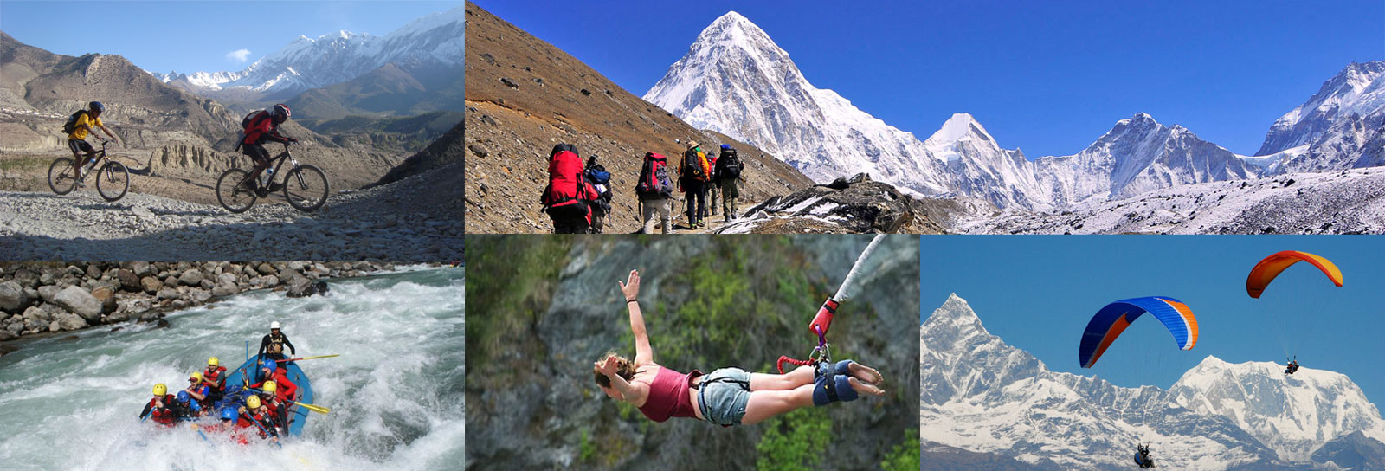
Introduction
Nepal offers stunning landscapes, including the Himalayas and Mount Everest. Rich cultural heritage, ancient temples, diverse wildlife, and adventure activities like trekking and white-water rafting make it an enticing tourist destination that is directly creating impact in Nepal’s GDP.

Slide 3
Literature Review
In a study conducted by Dharma Dhakal(ntb) in (2021), the authors evaluated the effectiveness of tourism websites in Nepal in terms of providing accurate and up-to-date information. They found that many tourism websites in Nepal lack accurate and timely information about tourist attractions.
Similarly, in a study by Tulsiram Adhikari in (2019), the authors evaluated the user experience of tourism websites in Nepal. They found that many tourism websites in Nepal lack user-friendly interfaces and navigation, which can result in a frustrating user experiences.
Finally, in a study by Sitaram Khatri in (2018), the authors evaluated the role of social media in promoting Nepal's tourism industry.

Slide 4
Objectives
To provide accurate and up-to-date information about Nepal's cultural, natural, and adventure attractions, as well as practical information about transportation, accommodations, and visas.
To improve the website's design and user experience to make it easy for visitors to navigate and find the information they need.
To promote the hidden treasures like waterfalls, lakes, ponds, etc. appealing the domestic tourists around the country.

Slide 5
Statement of problems
In the context of present scenario, Tourism website in Nepal may face competition from other websites that offer similar or more comprehensive information about the country's tourism industry. Our website may contain outdated information, such as incorrect details about tourist attractions, transportation options, or visa requirements. This can lead to confusion and frustration for visitors and may even deter them from visiting Nepal.

Slide 6
Methodology
In the context of a project, methodology refers to the systematic approach or set of principles used to plan, execute, and control the project from start to finish.
The choice of methodology depends on the nature of the project, its goals, and the specific requirements.
Waterfall methodology is a sequential project management approach that divides a project into distinct phases, with each phase being completed before moving on to the next.

Slide 7
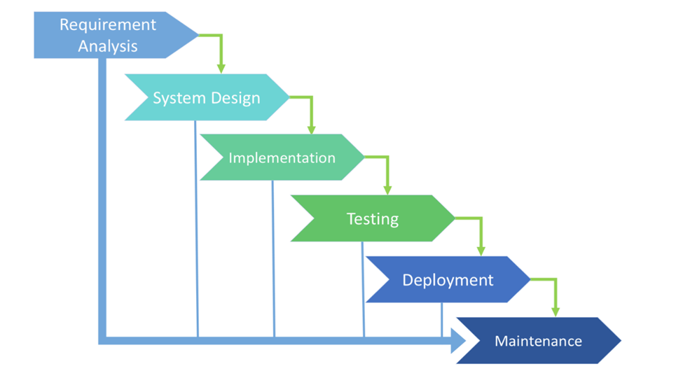
Methodology

Slide 8
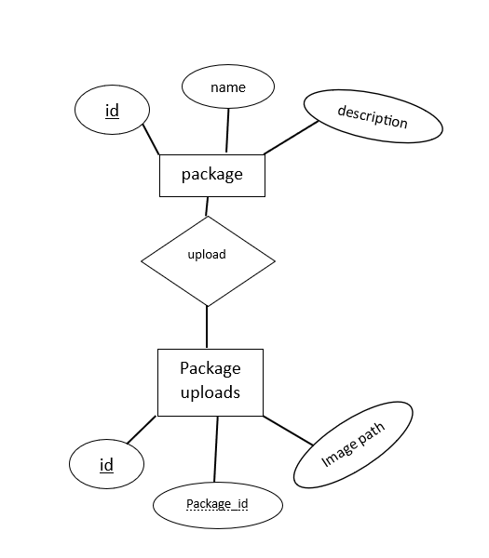
ER Diagram

Slide 9
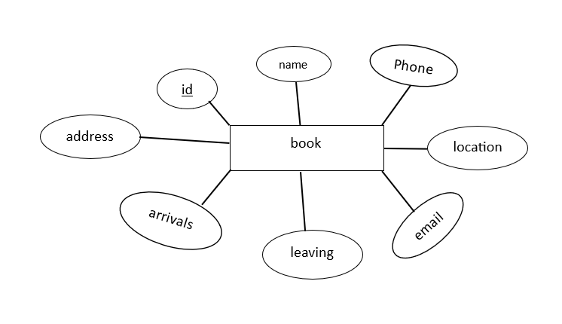

Slide 10
Technologies used
Front End
HTML 5: standard markup language for documents to be displayed on web browser
• CSS 3: describes the presentation of HTML
• JavaScript: describes the behavior of web page
Back End
• PHP: server-side scripting language
• MySQL: relational database management system (DBMS)

Slide 11
Development Tools used
• Visual Studio Code: Integrated Development Environment (IDE) for web development
• Xampp: All-in-one package containing Apache server, PHP and MySQL
• Firefox, Google Chrome: Web Browsers for testing source code.
• Adobe Photoshop: Raster image processing Software
• Brave, Google Chrome: Web Browsers for testing source code

Slide 12
Work Progress
Accomplished Work
A responsive and effective project on tourism website has been made, with the completion of the following tasks:
Design and Front-End Development
Back-End Development
Database Design
Testing and Debugging
Documentation

Slide 13
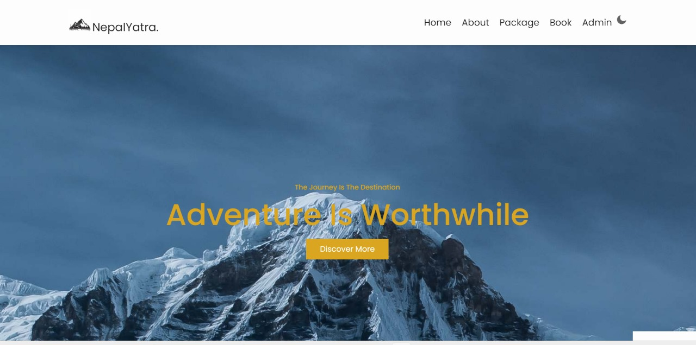
Outputs

Slide 14
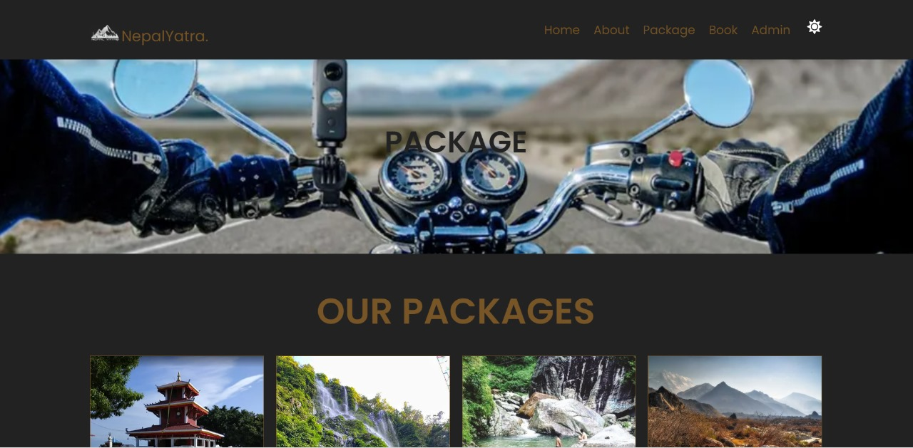

Slide 15
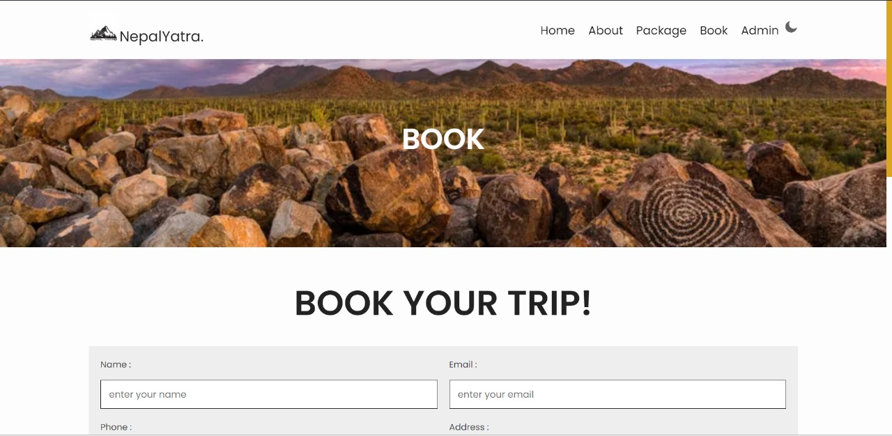

Slide 16
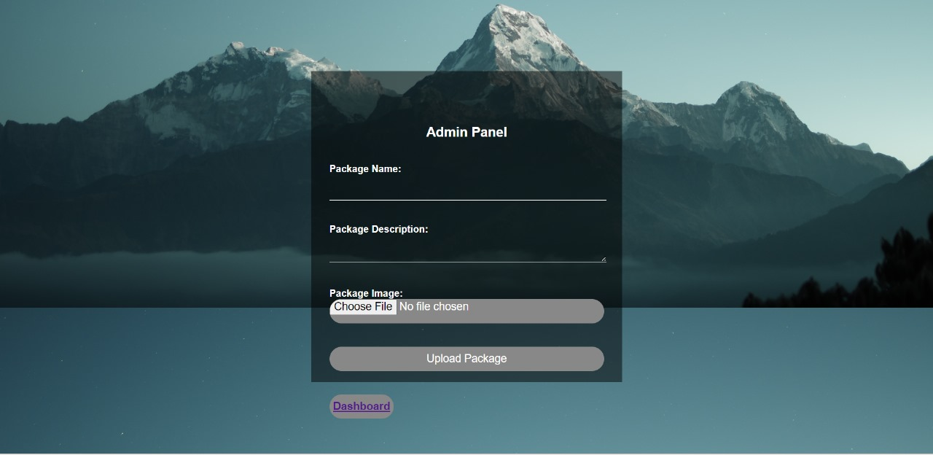

Slide 17
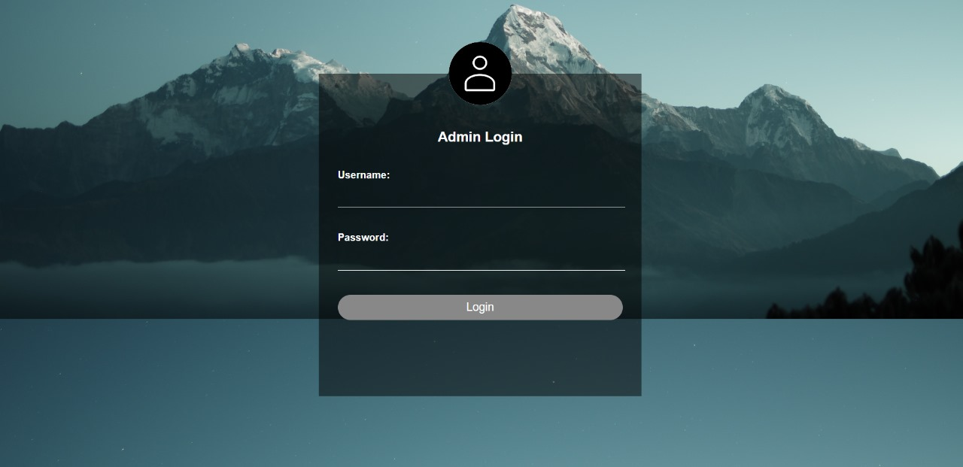

Slide 18
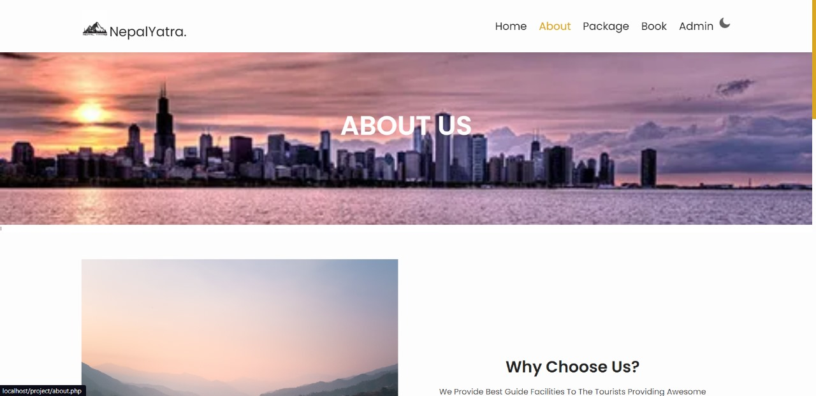

Slide 19
References
Banjara, Ram. "A Journey Through Time: The Evolution of Tourism in Nepal". Himalaya Land Treks & Expedition. Retrieved 28 March 2023.
Government of Nepal, Ministry of Culture, Tourism & Civil Aviation. "Nepal Tourism Statistics 2021" (PDF). Retrieved 27 March 2023.
https://ntb.gov.np/ (online)
https://www.visiticeland.com/ (online)

Slide 20
Future Enhancement
Payment Gateway
Formation of Management Team
Deployment

Slide 21
Thank You!

